Slide 1
Re-imagining standards and recognitions in the changing landscape of tertiary education
Fiona Gunn SFHEA | Alex Walker PFHEA

Slide 2
Do you hold:
GTCS
HEA Fellowship
Both
Neither
If you selected both, why did you seek HEA Fellowship in addition to GTCS?
Does your professional identity feel most aligned to:
Further Education
Higher Education
Tertiary Education

Slide 3

In this session we will explore:
The changing landscape of education towards a tertiary identity;
The Professional Standards for Lecturers in Scotland’s Colleges and Professional Standards Framework (PSF) for teaching and supporting learning in higher education 2023;
Our tertiary identity through the lens of standards and recognitions offered through UHI including GTCS and HEA Fellowships.
Notes:
Alex Walker: In the session we will explore…
We hope that you will join the discussion and will stop every couple of slide to invite reflections.

Slide 4



Move towards a tertiary identity
Call for proposals for a JPAAP Special Issue focusing on our Tertiary landscape.
SHED Event: Challenges and Opportunities for Academic Development across the Scottish Tertiary Sector
Scottish Government supports “a single quality assurance and enhancement framework for tertiary education”
Notes:
Alex Walker: Move towards a tertiary enhancement framework. Advance HE guidance for lectures in colleges to contextualise fellowships to. SHED (Scottish Higher Education Developers) group acknowledging and opening up their group to be more tertiary focused. JPAAP Special issue focused on tertiary.

Slide 5
Professional recognitions and standards
General Teaching Council for Scotland’s Colleges (GTCS) and Professional Standards for Lecturers in Scotland's Colleges
Advance HE HEA Fellowships and Professional Standards Framework (PSF)
https://www.gtcs.org.uk/wp-content/uploads/2021/09/professional-standards-for-lecturers-scotland-colleges.pdf
https://www.advance-he.ac.uk/knowledge-hub/professional-standards-framework-teaching-and-supporting-learning-higher-education-0
Notes:
Quiz Fiona covering GTCS: The General Teaching Council for Scotland is a fee based registered charity and the world's first independent registration and regulation body for teaching. Within UHI colleagues employed at in scope colleges must gain GTCS registration through completion of the TQFE or a record of experience. The exception to this being SAMS and I believe HTC.
Colleagues moving to UHI from other universities need GTCS if in scope college. If colleagues move to another college in Scotland, they need GTCS.
Alex covering PSF/Fellowships: What it is (very briefly) and then reasons why colleagues might seek it: Not contractual at UHI but is in many HE universities, and embedded into probationary periods. Colleagues moving from UHI to other university need Fellowship and not GTCS. Although not contractual since 2016 around 188 colleagues have sought HEA Fellowships so recognise the value, both in relation to CPD but also in relation to HE standards and identity. Professional services can apply for HEA Fellowships – professional recognition for supporting learning and teaching. Numbers of colleagues seeking fellowship has not declined with the requirements of GTCS. Some evaluative work to do on the reasons why colleagues continue to seek fellowship: May refer back to quick at the start.
Recognitions or memberships hold value at and beyond UHI but often there is overlap in the activities needed to gain either GTCS or Fellowships, including working towards a relevant teaching qualification or completing a portfolio of practice.

Slide 6
Commonalities of the Professional Standards for Lecturers in Scotland’s College and Professional Standards Framework for teaching supporting learning in higher education
Notes:
Alex: It is worth exploring the commonalities of both professional standards in relation to considering our own tertiary identity.

Slide 7
Purpose
The Professional Standards Framework:
Fosters critically evaluative, reflective and evidence-informed approaches to teaching and/or supporting learning in diverse academic or professional settings;
Provides a structure through which individuals and institutions may gain recognition for approaches that support high-quality learning;
Enables individuals and institutions to review and enhance practices in teaching and/or supporting learning, providing a focus for initial and continuing professional development;
Provides a structure to support institutions and individuals in advancing higher education practices to meet the evolving needs of learners and society, such as acting in support of the United Nations Sustainable Development Goals.
Professional Standards for Lecturers in Scotland’s Colleges:
Developing critically reflective and evaluative practitioners;
Underpinning professional teaching qualifications for lecturers in Scotland’s colleges;
Supporting professional development; and
Contributing to ongoing developments across the sector.
Notes:
Fiona

Slide 8
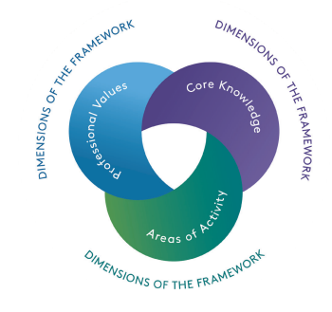
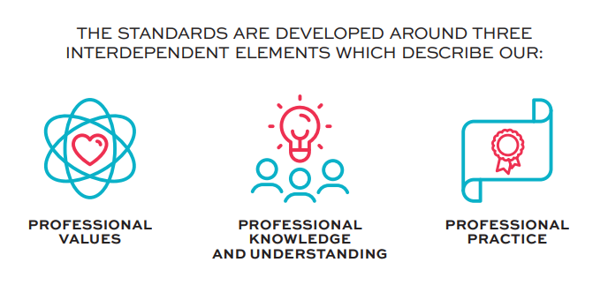
Three dimensions
Notes:
Alex Within the both standards there are three common dimensions including professional values, knowledge and practice or areas of activity, there are a number of standards that colleagues are expected to demonstrate in their FE or HE practice.

Slide 9
Commonality between the standards: just a taster…
Professional Standards for Lecturers in Scotland’s College: | The Professional Standards Framework:
Understands how to meet the diverse needs of students. | Respect individual learners and diverse groups of learners.
Commits to equality and diversity, and promotes inclusiveness, trust and fairness. | Promote engagement in learning and equity of opportunity for all to reach their potential
Understands how to support a student to take the next steps in their learning journey. | Support and guide learners.
Continuously and actively engages with up-to-date research and developments in learning, teaching and assessment to inform practice. | use scholarship, or research, or professional learning, or other evidence-informed approaches as a basis for effective practice.
Political, social and economic drivers. | Respond to the wider context in which higher education operates, recognising implications for practice.
Critical reflective and collaborative practice in learning and teaching. | Collaborate with others to enhance practice.
Understands the strategies required to support learning in a range of learning environments. | Teach and/or support learning through appropriate approaches and environments
Notes:
Alex When you looks at the standards outwith the dimensions and map the standards against one another which we have done for this presentation you find a number of commonalities, here are a just a few examples…These are just some of the more explicit examples but there are many other explicit and implicit ones. When you take all the standards across the Professional standards frameworks we found that all could be mapped against the other.

Slide 10

Re-imagining recognition routes
Advance HE taking a tertiary approach to HEA Fellowships?
UHI taught recognition routes (TQFE and PgCert) being recognised by both Advance HE and GTCS to offer both HEA Fellowships and GTCS registration?
ALPINE Portfolio route leading to multiple professional recognitions as appropriate to individual (recognised by Advance HE, GTCS, ALT etc)?
GTCS and Advance HE agreeing one tertiary standards for staff in colleges?....
Notes:
When I started out preparing for this session my aim was to discover the common values that define our tertiary identity through the professional standards for lecturers in Scotlands colleges and through the PSF. What I realised once I began exploring these standards is that both are essentially saying the same thing, the values map beautifully together with very little divergence. Identity then is perhaps more defined by the space that we practice, the language that we use that separates FE and HE, an example yesterday was given by Sharon and Carrie about units or modules but also the boundaries placed through our recognition practices if they are defined as FE or HE. Our values don’t change in these spaces but our identity might depending on what is happening in that space. Opening up some of our internal recognition routes like Alpine to include other types of recognition to move it towards a more tertiary space would be an obvious option but the sector needs to also consider the spaces that they occupy and their own identity and as we have seen that is beginning to shift towards tertiary identity that for UHI can only be a positive step in underlining and valuing our tieriness. Perhaps in the future sector bodies like GTC and Advance HE might work together to define tertiary standards so that colleagues didn’t feel like they were duplicating effort across the two recognitions.

Slide 11
Re-imagining standards (testing the concept)
Professional commitment and values | Commits and can demonstrate meeting the needs of individual learners and diverse groups of learners. Commits and promotes equality and diversity and empowers learners to reach their potential through support and guidance. Commits to evidence informed approaches and development of subject and pedagogic knowledge contextualised to individual’s context and relevant across tertiary levels of study and learners needs. Commits to student/learner, peer, and partner collaboration enabling co-creation, wellbeing, and inclusivity.
Professional understanding and development of knowledge | Understands and responds to internal and external drivers, policies and contexts that influence tertiary curriculum and practice. Understands and promotes quality enhancement and assurance within their practice and to enhance the learner experience. Understands and utilises digital technologies and resources to enhance practice, learner experience and belonging. Understands the importance of and demonstrates a commitment to continuing professional development to enhance own and others practice and positively impact the learner experience.
Professional Practice and Activity | Design and plan learning activities and/or programmes and/or curriculum that champion tertiary transitions through and beyond education. Utilises learning environments to deliver and/or support learning that is appropriate for the subject and level of study. Engages in critical reflection, student and/or peer feedback and evaluation of own practice and emerging practices to embrace change and practice development. Design and deliver assessment and feedback approaches that are relevant to the subject and future employment and are inclusive and equitable.
Notes:
Alex: Just to explore the last point, we took the standards across Professional Standards for Lecturers in Scotland’s College and Professional Standards Framework for teaching supporting learning in higher education 2023 and took the commonalities and tweaked them into a set of tertiary values. We will send them to you after the session, and would love to know…

Slide 12
Would there be value to having one standards framework for learning and teaching in tertiary education in Scotland (and beyond)?
Notes:
Fiona: Recognising that we are a unique tertiary institution and we deal with parallel quality enhancement and recognition frameworks. This might some way off but if we moved to one framework wta…Whilst we are seeing this through a theoretical perspective, doesn’t change the fact that neither recognise the other.

Slide 13
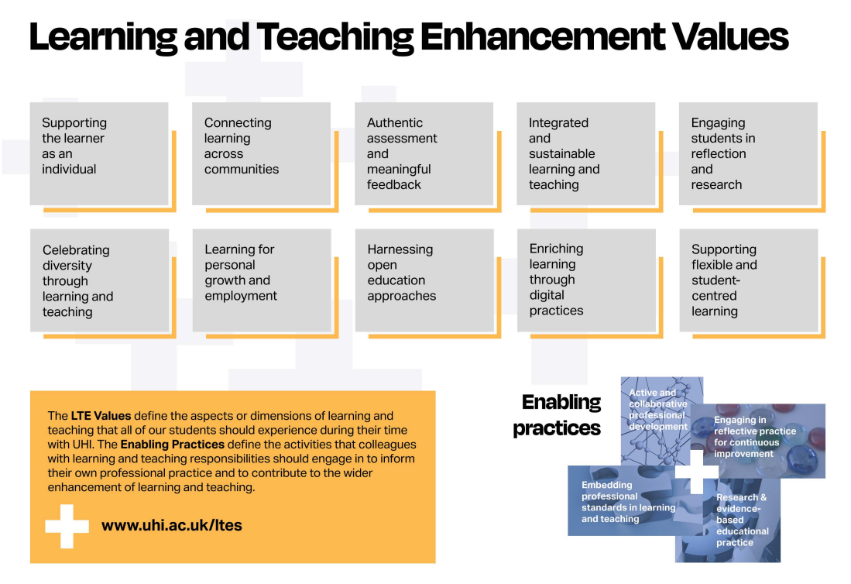
UHI Learning and Teaching Enhancement Strategy values
Notes:
Fiona: Acknowledging that we do have the strategy values that our common language
Funding, ALPINE, Course approval programme, quality assurance processes, aligning to events etc.

Slide 14
Thank you
Tapadh leibh
Notes:
Fiona

